Slide 1

Basic Details of the Team and Problem Statement
Ministry/Organization Name/Student Innovation: National Technical Research Organisation(NTRO)
PS Code: 1454
Problem Statement Title: Create an intelligent system using AI/ML to detect phishing domains which imitate look and feel of genuine domains
Team Name: Phishing Threat Defenders
Team Leader Name: Ravi Solanki
Institute Code (AISHE): U-0136
Institute Name: National Technical Research Organisation(NTRO)
Theme Name: Blockchain and Cybersecurity

Slide 2
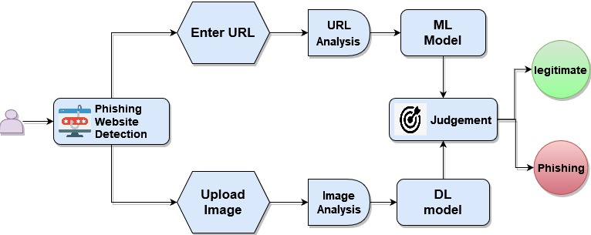
Idea/Approach Details
Idea/Solution
Advanced Machine Learning(Logistics Reg.) and Deep Learning(VGG16) techniques are used to analyze web page content and image structure, allowing the system to identify between authentic and phishing domains.
Create a user-friendly interface which also have multi linguistics support in near future that allows security experts and is also layman friendly for people in different countries and states to quickly access and comprehend detection data with official report.
Establish a real-time monitoring strategy to detect and respond to new phishing domains as they develop, thereby lowering the window of susceptibility.
We are also working on scalable model of this project.
Chatbot, API, URL Validation, Better Frontend and report in different formats and languages are the future prospects.
Technology Stack
Data collection: Open Source Database, Web scraping
Machine Learning: Python, Scikit Learn, NLTK
Deep Learning: Tensorflow, Keras
Web Development: Flask, HTML, JavaScript, CSS
Chatbot: Azure Cognitive Services
Model Deployment: AWS / Azure
Real-Time Management: Apache Kafka
Security & Firewall: AWS WAF, SSL, SQL/XSS

Slide 3
Idea/Approach Details
Use Cases
Show Stopper
Enterprise Email Security: The system safeguards businesses from email phishing.
Financial Services Fraud Prevention: The system's role in financial security through phishing domain detection and fraud prevention.
Government Cybersecurity: The system protects government agencies from phishing threats, including disinformation campaigns, safeguarding critical infrastructure and national security.
E-commerce Fraud Prevention: The system identifies fake e-commerce sites, enhancing online shopper safety and trust.
Social Media Safety: Our system's part in securing social media platforms by detecting and blocking phishing links, and preventing scams.
Data imbalance: With more legitimate domains, hampers training and may reduce phishing detection accuracy.
Adversarial Evasion: Sophisticated adversaries can craft phishing domains to evade detection, posing a constant challenge to staying ahead of evolving tactics.
False Positives: Balancing accurate detection with minimal false positives is challenging, as high false positives can disrupt user experience.
Real-Time Detection: Achieving real-time detection while minimizing latency is essential for preventing user access to malicious sites.
Product Status:
Our product prototype development is in its final stages, and we are diligently progressing towards the completion of our final product.

Slide 4
Team Member Details
Team Leader Name: Ravi Solanki
Branch: BSc Stream: Data Science Year: III
Team Member 1 Name: Shani Darji
Branch: BSc Stream: AIML Year: III
Team Member 2 Name: Manav Patel
Branch: BSc Stream: AIML Year: III
Team Member 3 Name: Meet Solanki
Branch: BSc Stream: AIML Year: III
Team Member 4 Name: Shreya Shah
Branch: BSc Stream: AIML Year: III
Team Member 5 Name: Vrunda Bhuva
Branch: BSc Stream: AIML Year: III
Team Mentor 1 Name: Type Your Name Here
Category (Academic/Industry): Expertise (AI/ML/Blockchain etc): Domain Experience (in years):
Team Mentor 2 Name: Type Your Name Here
Category (Academic/Industry): Expertise (AI/ML/Blockchain etc): Domain Experience (in years):

